Slide 1
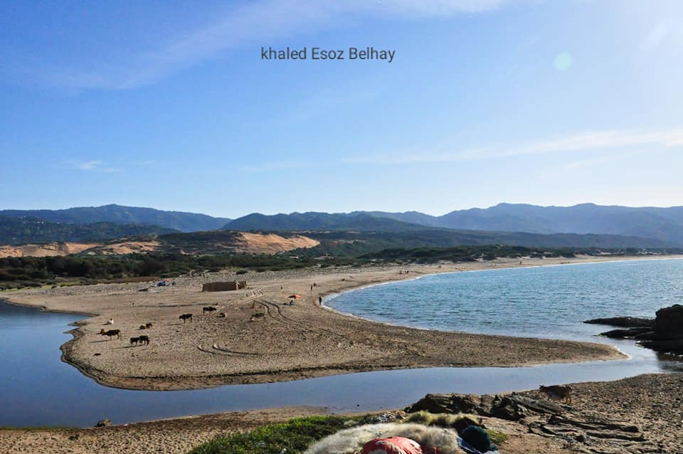
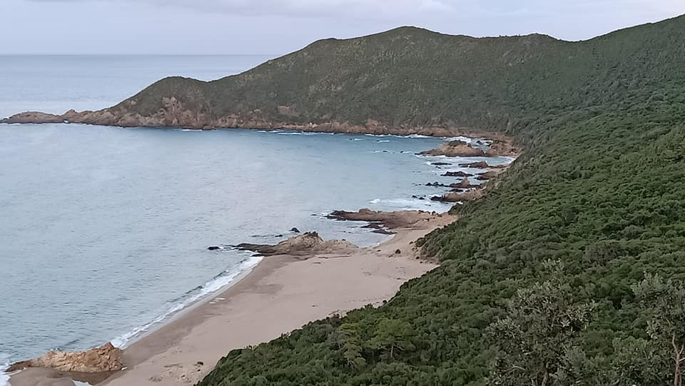
Project Protection of the environment and Biodiversity of the Algerian coast Skikda Action project wheat road yoghourta lala azhor
Oued Z’hor
Oued Zhor
Tamanart

Slide 2
DEMOCRATIC AND PEOPLE'S REPUBLIC OF ALGERIA Sustainable development and ecotourism association Skikda (green collo)
Project Protection of the Environment and Biodiversity of the Algerian Coastline Skikda
Yoghurt Lala Azhor Wheat Road Action Project
Analysis and diagnosis of the project, the organization of users of natural resources at the level of the Wilaya Skikda
(Collo a lala zhor)

Slide 3
This project is the culmination of the thematic work carried out by green Collo who participated in this project. It includes sustainable development aspects and the action plan with a view to integrating the local population into projects. The projects in question have a biodiversity and environmental character thus respond to the concerns of valuing the coastline for local development.
Introduction
By carrying out the green Collo project, we are providing the means to inventory all the capacities in the environmental field likely to be reinforced as part of the construction of the wheat road.
This will mainly involve identifying, confirming and examining the priority actions to be carried out in the field of biodiversity, that of the coast and that of the environment and sustainable development.
In a second step, I will need to examine the local capacities which need to be strengthened both at the project and coastal level.
In a third step, it will be necessary to target and then coordinate the actions and subsequent requests of local populations in terms of local development and the creation of a job.
Finally, the main project measures should be linked to enhance and hinder the environment and biodiversity and sustainable development.
In the willaya of Skikda

Slide 4
Project rationale and context
For the Skikda part, it will be a question of preparing a project highlighting, for the three sectors listed above, the priority issues, the capacity constraints and the possibilities for strengthening these capacities.
The context in which the project fits includes several phases: the first consists, on the basis of the work that has already been undertaken in the field of biodiversity, climate change and desertification and soil degradation, to assess the weak points.
Then, they will act to inventory the activities carried out for this evaluation and which consists of a sectoral inventory of the situation in order to select the aspects that justify a priority treatment and to define the constraints related to the existing capacities and especially those to be mobilized.
Once these two phases are completed, they will be possible for sectoral and intersectoral actions which should be and to strengthen capacities in terms of biodiversity, climate change and the fight against desertification and soil degradation.
The development of a capacity building and preservation strategy, both at the sectoral and intersectoral level, will constitute the final phase of the self-assessment mission.

Slide 5
It makes sense that the preparation of the ANCR involves several administrations and institutions whose activities relate in whole or in part to activities which have an impact on the environment.
By evaluating the dysfunctions observed in the management of the national environment, the institutions will be able to coordinate their efforts and seek the synergies that will strengthen existing capacities so as to be able to maximize national and international programs to fight against environmental degradation and the preservation of sustainable development.
QUESTIONS Coastal interest
A. CONSTRAINTS
The analysis of coastal issues and the needs of municipalities in this area first requires that the constraints to the implementation of the proposed solutions be clearly identified and known.

Slide 6
In this context, and from the poor conclusions to which the various projects arrived, the absence of sustainability, the economic constraints, the absence of methodologies, guidelines, good practices, case studies and tools, institutional fragmentation, the absence of understanding, demotivation and social obstacles, will certainly be felt, added to to the implementation of a coastal approach which nevertheless generates greater rationalization of resources and greater efficiency in the process. Indeed, "capacity building is defined as an endogenous process through which a civil society, its associations, increases its human capital and improves its faculties of reaction, adaptation and self-discipline - employment of local wealth".
We will also add the initial concerns related to the lack of knowledge and expertise in the municipalities cited to comply with the provisions of the three projects; the lack of knowledge of the links between the strategies contained in the latter and the achievement of local sustainable development objectives and the weakness of the capacities to take advantage of the possibilities offered by these projects at the regional level.
The approach of these projects is based on an approach for strengthening human capacities and techniques adapted to local specificities, starting from awareness-raising, training and action activities covering the various aspects of the implementation of the three projects, in particular: awareness-raising of the local population, NGOs and grassroots populations, strengthening of a local implementation structure, training of local teams, technical studies, participation in local meetings. This approach is based on local expertise.

Slide 7
IDEAS OF PILOT PROJECTS WITH STRONG DOMINANT
GOALS :
enhancement of the local product (forest - aromatic medicinal plant - clay) (rosemary - clay - oil of local honey - forest fruit - mushroom.
-Improved quality of life,
-Regeneration of the coastline (marine-forest-biodiversity)
-Regeneration of degraded courses and restoration of their productivity, (ecotourism- forest)
-Rational use of the local product
-Integrated management of spaces (ecosystems),
-Beneficial to rural communities,
-Alleviate poverty,
- Job creation
-Better biodiversity management,

Slide 8
PROJECT 1
THE INTEGRATED DEVELOPMENT of an ecotourism and camping area (charia-ouled attia-oued zhor)
Rehabilitation of space and road to elgougi and habieche (2nd willaya)
Local development and enhancement of the maritime coastline natural and maritime reserve to be developed across the three municipalities (collo –ouledattia- ouedzhor
• Project partner: commune (ouled attia-oued zhor-chérai) direction (tourism-sport environment).
• Existing Situation: Ideal space for camping, ecotourism, solidarity tourism. Diving-memory-astronomical
• Proposed technological solution: Rehabilitation of the space for camping and road to the Elgoufi mountain of the twin to look at the sky and astronomy - rehabilitation of the historic Emme willaya monument tourism of memory
• Project lifespan: 12 months 12/24/2020 to 12/24/2021
• Carbon reduction potential: Once reconstituted, the plant cover will contribute to the sequestration of 46,000,000tCO2 using an average of 37Tco2 / ha / a
600,000,000da

Slide 9
PROJECT 2:
Marine diving training club
• Project partner: management (sport - fishing - tourism - environment) -
• Existing Situation: local threats to coral ecosystems
(such as overfishing, pollution or destruction of habitats) are mainly
of two concepts:
1- The one that explains why
there is generally little individual interest in sustainable use of goods
in common or public since the cost of the action will be borne by individuals while
that the benefits will benefit the group or future generations; overfishing is
a perfect example, motivated by the idea that "any fish that I don't catch can
potentially being taken by my neighbor ”.
2- That of externalities for which the absence of exchange space or "market"
values ​​inherent in ecosystem services does not make it possible to regulate
profits and losses linked to the quality of these services
maritime coast has conserved and enhanced with climate change and the local population around the coast

Slide 10
Goal,
Raise awareness of reef protection
Qualifying training to enhance the local marine coastline,
Creation and preservation of artificial reefs,
Realization of maritime reserves
Establishment of Posidonia meadows
Preserving reef biodiversity hindering the training of young people in maritime diving
Commitment and adhesion of the local population to the development of the maritime and forest coastline
Proposed technology solution: Application of software. Reforestation Forest plantations on the local sea coast (tresinous broadleaf) and fruit on 1,000 ha and other consolidation actions.
Location: Collo tamanaret oued zhor.
Project life,
.24 / 12 / 2020a 24/12/2021
Project cost: 3,500,000.00da

Slide 11
PROJECT 3:
PROMOTION forest fruit AND VALUATION OF medical and aromatic plants and oil FOR THE VALUATION of the forest and biodiversity in rural settings (Collo-oued azhor)
Project partner: joint management (forest -environment -agriculture) (Collo.Chérai ouled attia-oued zhor)
Existing Situation: Very large and landlocked spaces, biodiversity, the forest of (Collo a ouedzhor), a thousand hectares points for cultivating and focal point ‘ouled attia - oued zhor) has established
Technology solution proposed: use of machine equipment for oil extract (drau oil).
Aromatic plant equipment (rosemary)
Project lifespan: 12 months 12/24/2021
Baseline for wealth creation and local employment.
Valuation potential: (Skikda) valuation of the coastal coastal forest of (Collo-oued zhor) hundreds of hectares to be disturbed

Slide 12
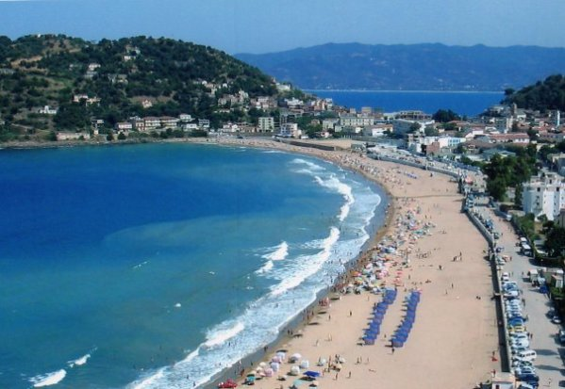
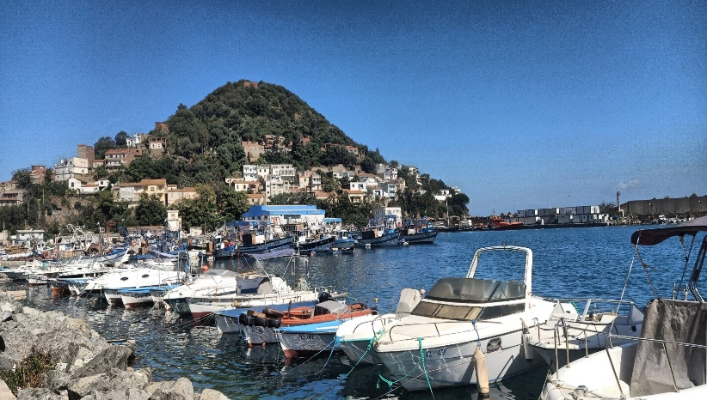
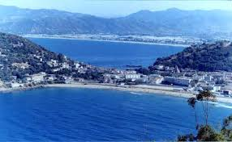
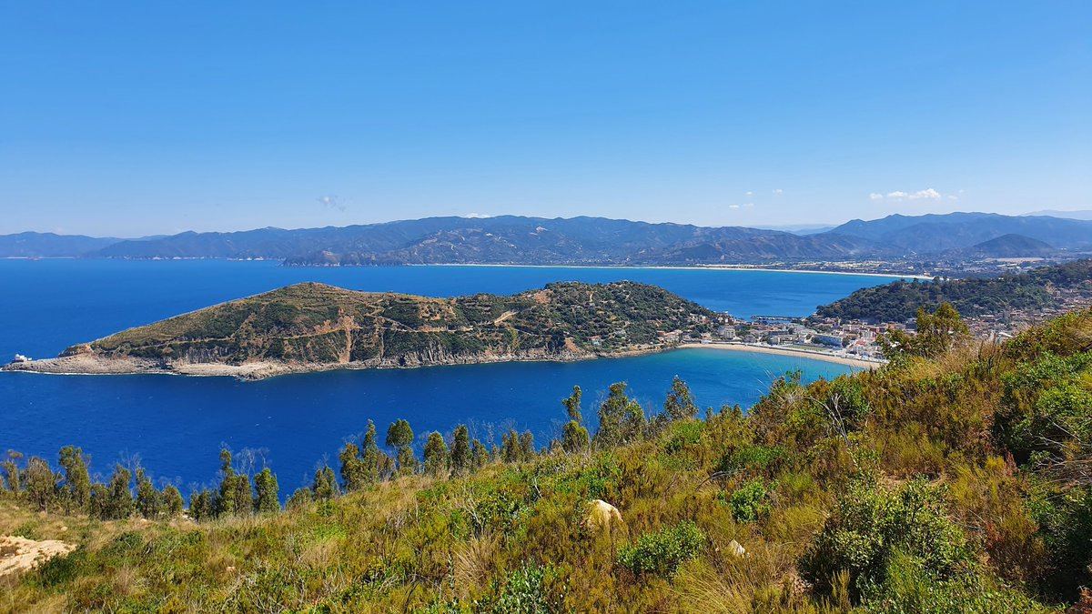
Photos
Photos de collo .

Slide 13
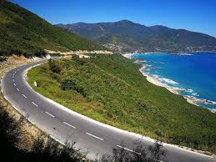
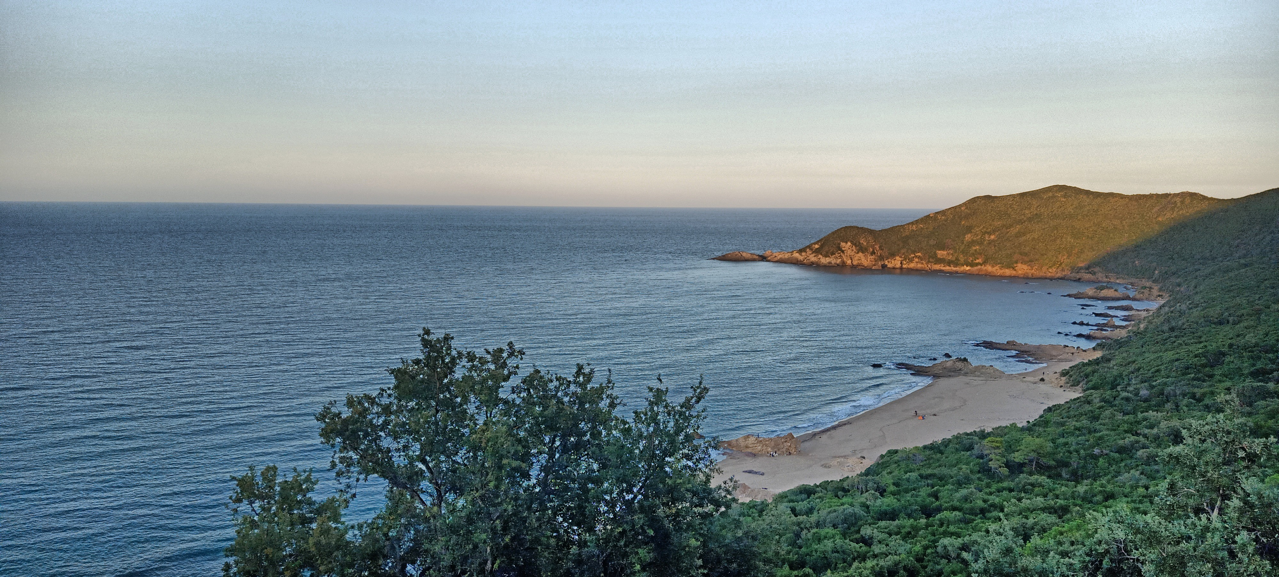
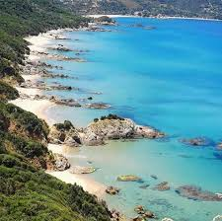
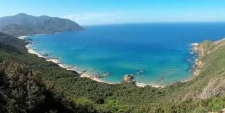
Photos de tamanart.

Slide 14
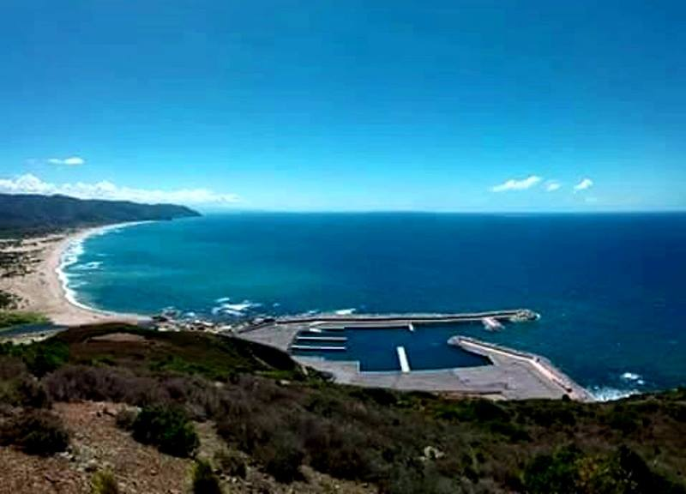
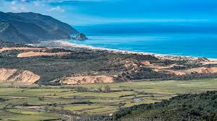
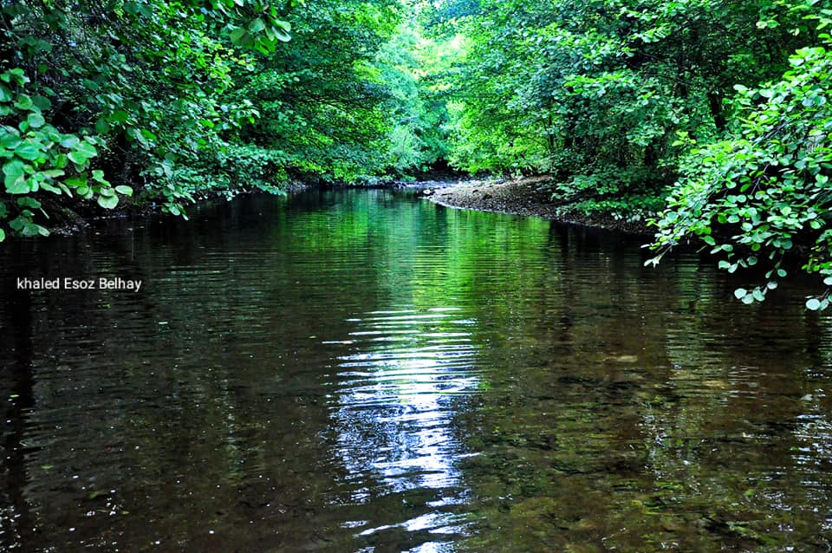
Photos de Oued Zhor.

Slide 15
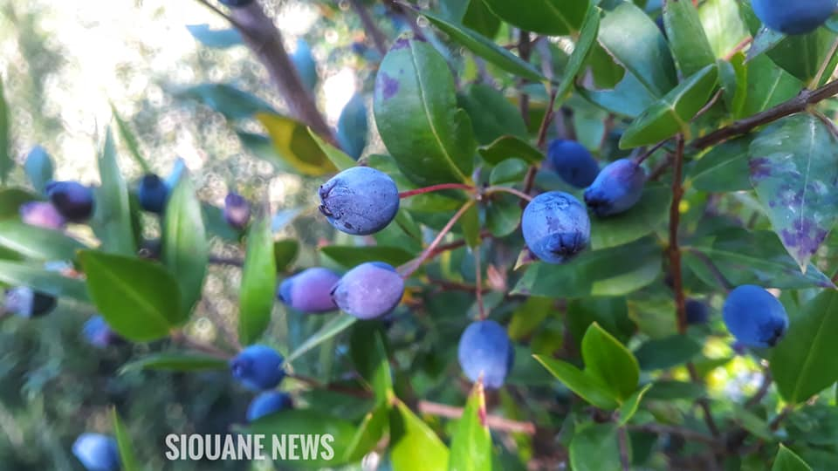
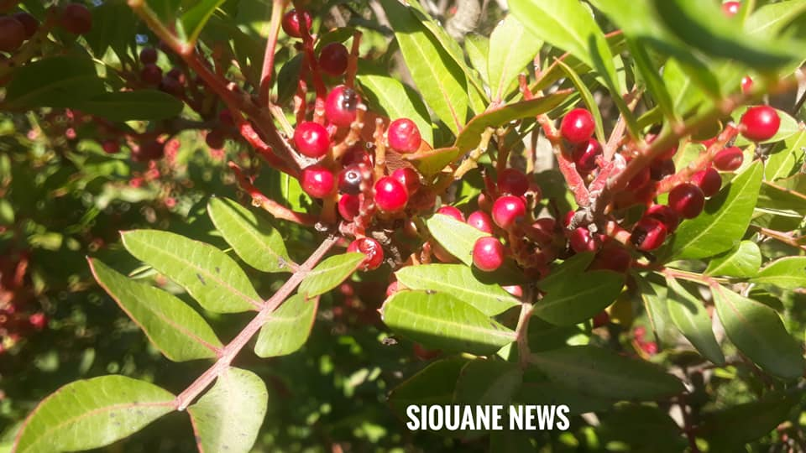
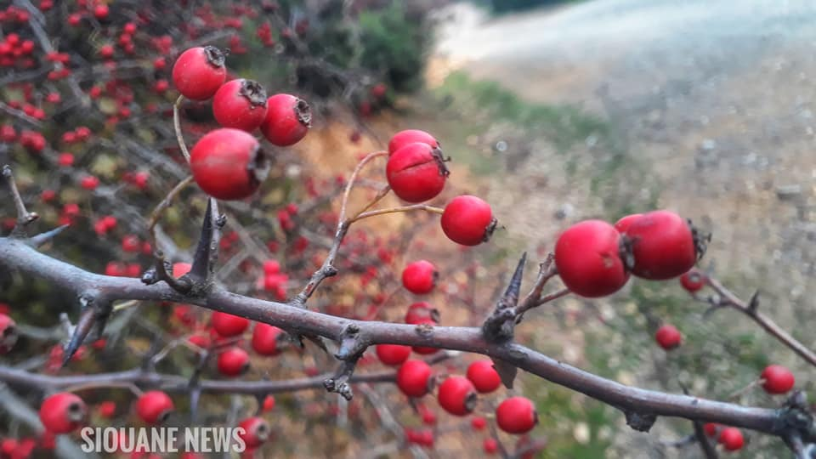
Les fruits littoral

